Slide 1
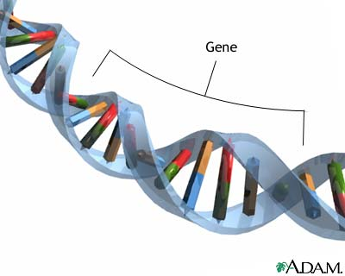
Microbial Genetics
د. نظام جمال الدين
كلية الطب\جامعة البصرة

Slide 2
Objectives
The objectives of this lecture are to:
Describe the general properties of DNA & RNA and its
molecular aspect as well as their replication process.
2. Discuss the mutation and the mechanism of repair.
3. Assign a practical exercise.

Slide 3
Introduction
The science of genetics defines and analyzes heredity, or constancy and
change in the vast array of physiologic functions that form the properties of
organisms.
The basic unit of heredity is the gene, a segment of deoxyribonucleic acid
(DNA) that encodes in its nucleotide sequence information for a specific
physiologic property.
phenotype is an organism's observable characteristics or traits: such
as its morphology, development, biochemical or physiological
properties,
Genotype is the genetic makeup of a cell, an organism, or an
individual (i.e. the specific allele makeup of the individual) usually
with reference to a specific character under consideration

Slide 4
Structure of DNA & RNA
DNA: store the genetic information as a sequences of DNA
bases called nucleotide, Most DNA molecules are
double-stranded, with complementary base
(A-T; G- C) paired by hydrogen bonding with
antiparallel orientation
- One strand is chemically oriented in a 5‘…… 3‘
direction
- Its complementary strand runs 3‘…… 5‘

Slide 5
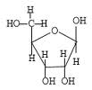
Structure of DNA & RNA cont.
Component 1 – phosphate
Functions as a structural part of nucleic acid
Component 2 – Ribose Sugar
A five carbon sugar that functions as
part of DNA backbone
Component 3 – Nitrogen bases
Functions…express genetic information
2 Purines……… Adenine A Guanine G
2 pyrimidenies…… Thymine T Cytocine C

Slide 6
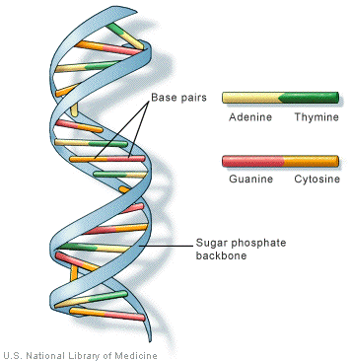

Slide 7
Structure of DNA & RNA cont.
B. RNA: Ribonucleic acid
Similar to DNA except:
RNA is single stranded
RNA has a ribose sugar instead of deoxyribose
RNA has Uracil (U) instead of thymine
RNA is always shorter than DNA.

Slide 8
Function of RNA
rRNA (Ribosomal) – comprises the ribosome (site of protein
synthesis) 60% of a ribosome is made of RNA, the rest is
protein.
tRNA (Transfer)- carries A. Acids to the ribosome during
protein synthesis. Also known as the “Anticodon”
mRNA (Messenger) – A complementary strand of RNA
equal in size to one gene (normally ˷ 1000 nucleotide).
“Codon”- coded info from DNA (bound for the ribosome)

Slide 9
Replication
The process of making an identical copy of a section of duplex (double-stranded) DNA, using existing DNA as a template for the synthesis of new DNA strands. In humans and other eukaryotes, replication occurs in the cell nucleus.

Slide 10
5’
3’
5’
Identical base sequences
3’
3’
5’
3’
5’
Watson/Crick proposed mechanism of DNA replication

Slide 11
Proposed Models of DNA Replication
In the late 1950s, three different mechanisms were proposed for the replication of DNA
Conservative model
Both parental strands stay together after DNA replication
Semiconservative model
The double-stranded DNA contains one parental and one daughter strand following replication
Dispersive model
Parental and daughter DNA are interspersed in both strands following replication

Slide 12
Three models for DNA replication

Slide 13
BACTERIAL REPLICATION
DNA synthesis begins at a site termed the origin of replication
Each bacterial chromosome has only one
Synthesis of DNA proceeds bidirectionally around the bacterial chromosome
eventually meeting at the opposite side of the bacterial chromosome where replication ends

Slide 14
Overview of bacterial DNA replication

Slide 15
BACTERIAL REPLICATION
DNA helicase separates the two DNA strands by breaking the hydrogen bonds between them
This generates positive supercoiling ahead of each replication fork
DNA gyrase travels ahead of the helicase and alleviates these supercoils
Single-strand binding proteins bind to the separated DNA strands to keep them apart
Then short (10 to 12 nucleotides) RNA primers are synthesized by DNA primase
These short RNA strands start, or prime, DNA synthesis

Slide 16
Uses energy from ATP to unwind the duplex DNA
SSB
SSB
SSB
SSB

Slide 17
Direction of synthesis
on leading strand
3’
5’
3’
5’
Direction of synthesis
on lagging strand
3’
5’
Two dimensional view of a replication fork

Slide 18
Mutations
Changes in the nucleotide sequence usually
due to an error in DNA replication. These
occur naturally at low levels (also known as
spontaneous mutations); or by the effects of
Chemical agents called mutagens; or by
physical agents like radiation

Slide 19
Types of Mutation
Spontaneous mutations –
Mutations are changes in DNA sequence occur with a
frequency of 10^{–6}–10^{–8.} The mutations include:
base substitutions, deletions, insertions, and rearrangement
There are 3 types:
Silent mutations – single base substitution in the 3rd base
Nucleotide Position of a codon. This results in No change in
amino acid.
Missense mutations – single base
Substitution in 1st or 2nd base nucleotide position. This results in
a changed amino acids. A change in one A.A usually will have
little effect depending on where in the polypeptide it occurs
Nonsense mutations – single base substitutions

Slide 20
Types of Mutation
Frame Shift Mutations –
the addition or deletion of 1 or more bases, these are due to
powerful mutagens; chemical or physical
Chemical mutagens – (used in research to study mutagenesis)
1. alkylating agents. Add alkyl group
2. base analogs. Mimics a nitrogen base
3. intercalating agents. Inserts into DNA and pushes bases apart
b. Physical mutagens:
1. nonionizing radiation- causes the formation of T=T dimers. UV
Light @260 nm
2. Ionizing radiation – damages DNA by causing the formation
of “free radicals” leading to mutations
X-rays, Gamma rays, alpha rays

Slide 21
Repair Mechanisms of DNA
Direct DNA repair: Is the enzymatic removal of damage such as Pyrimidine dimers
and alkylated bases.
2. Excision repair.. Is the excision of a DNA segment contain the damage, followed by
synthesis of a new DNA strand
3. Recombinational or postreplication repair.. Is the retrieval of missing information
by genetic recombination
4. The SOS response.. Is the induction of many genes after DNA damage or interruption
of DNA replication
5. Error-prone repair.. Is the last resort of a bacterial cell before it dies.
Random sequence

